Slide 1


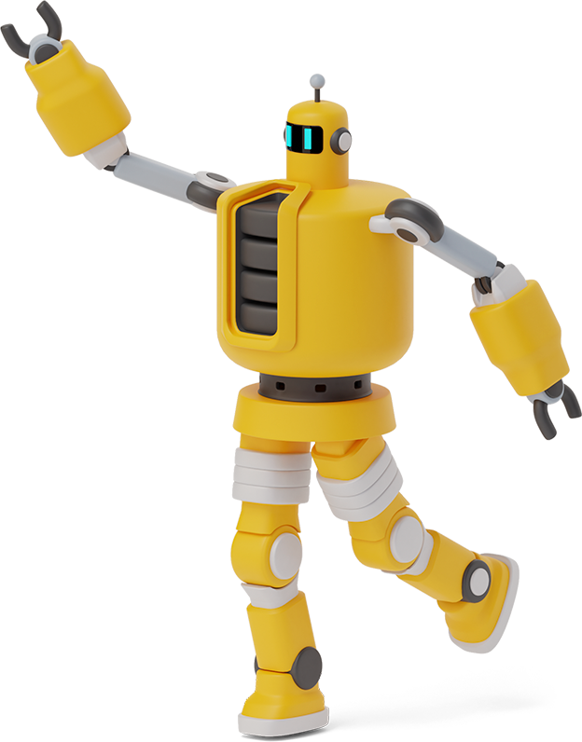
Vietnamese Social Media Emotion Corpus
NGUYỄN THANH TÙNG – 51800649
ĐÀO HOÀNG GIANG -518H0088

Slide 2

Our process is easy
Task 3(30%): Applying the trained model in Task 2 to three datasets in Task 1. Then,
Report performance metrics for datasets
03
Task 1(40%): Collecting data
.
01
02
Task 2(30%): Emotion Recognition for Vietnamese Social Media Text

Slide 3


Task 1: Collecting data
1
Let’s start with the first set of slides

Slide 4
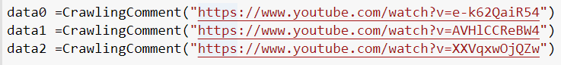
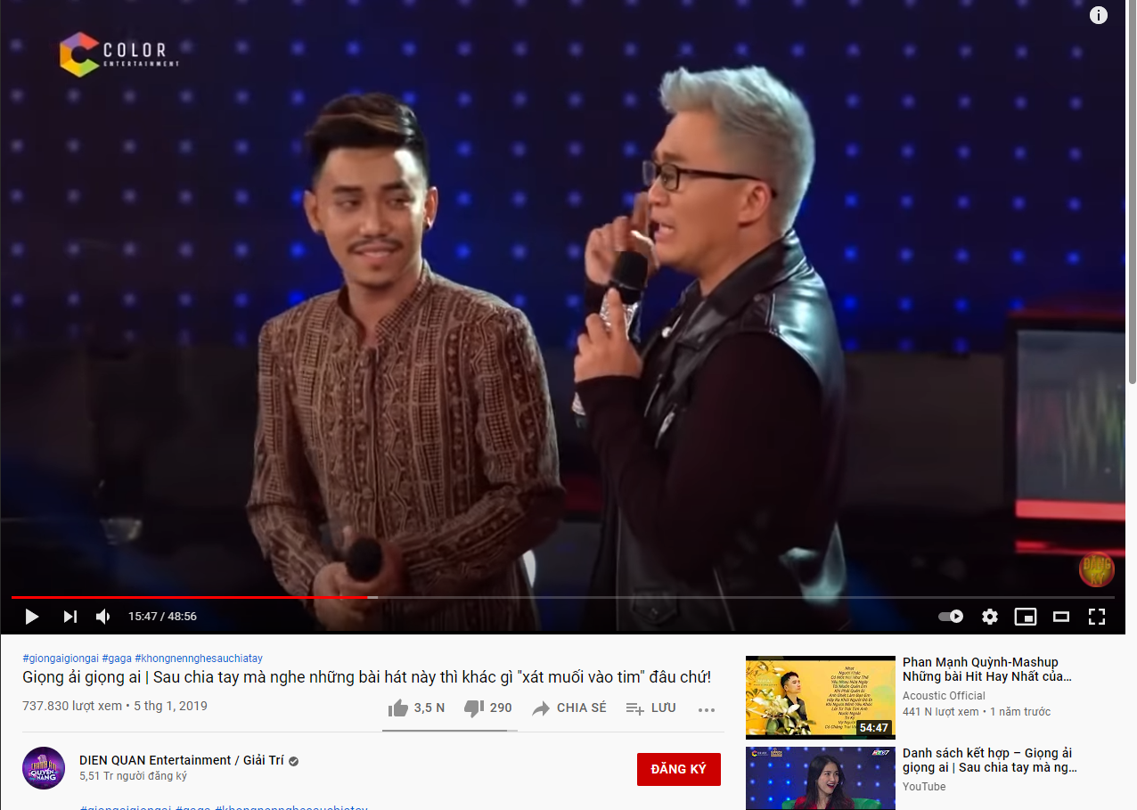
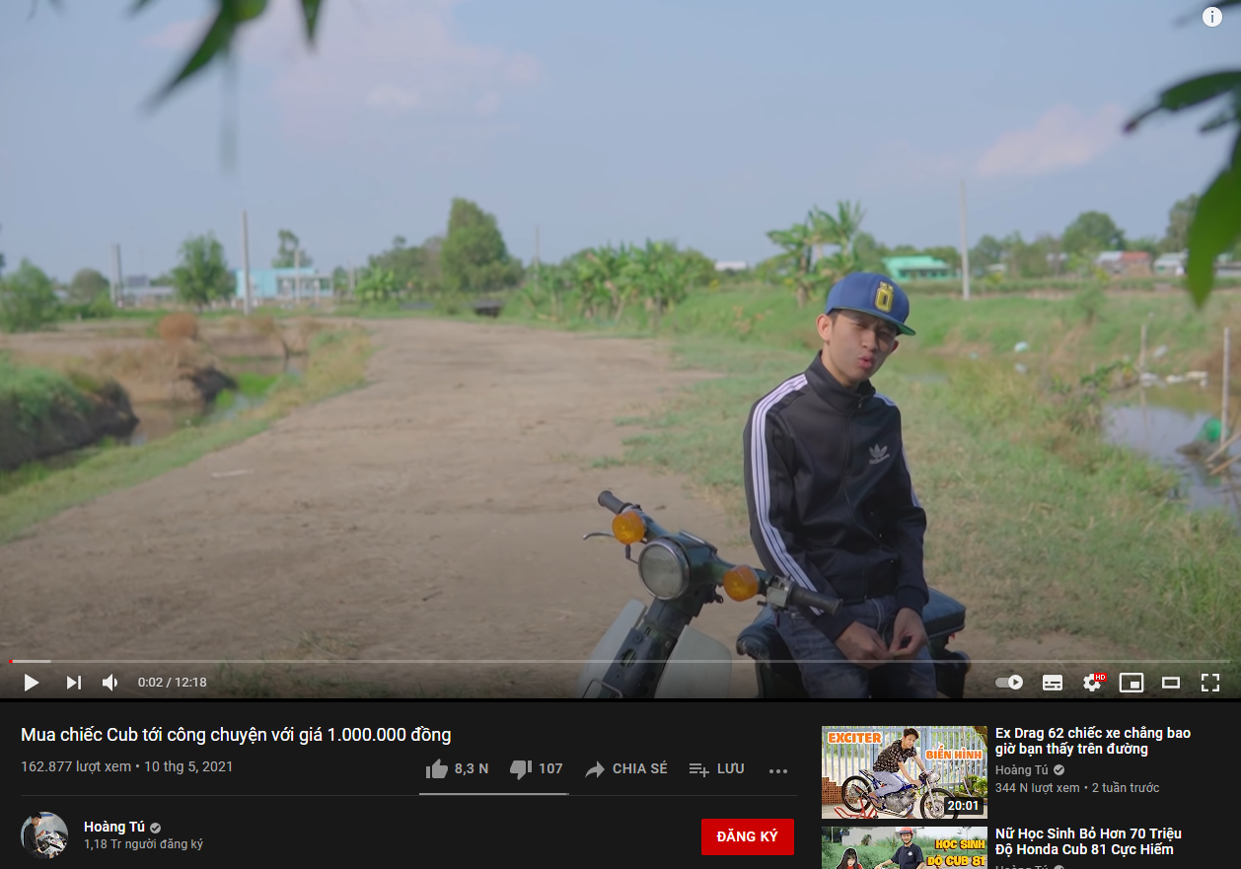
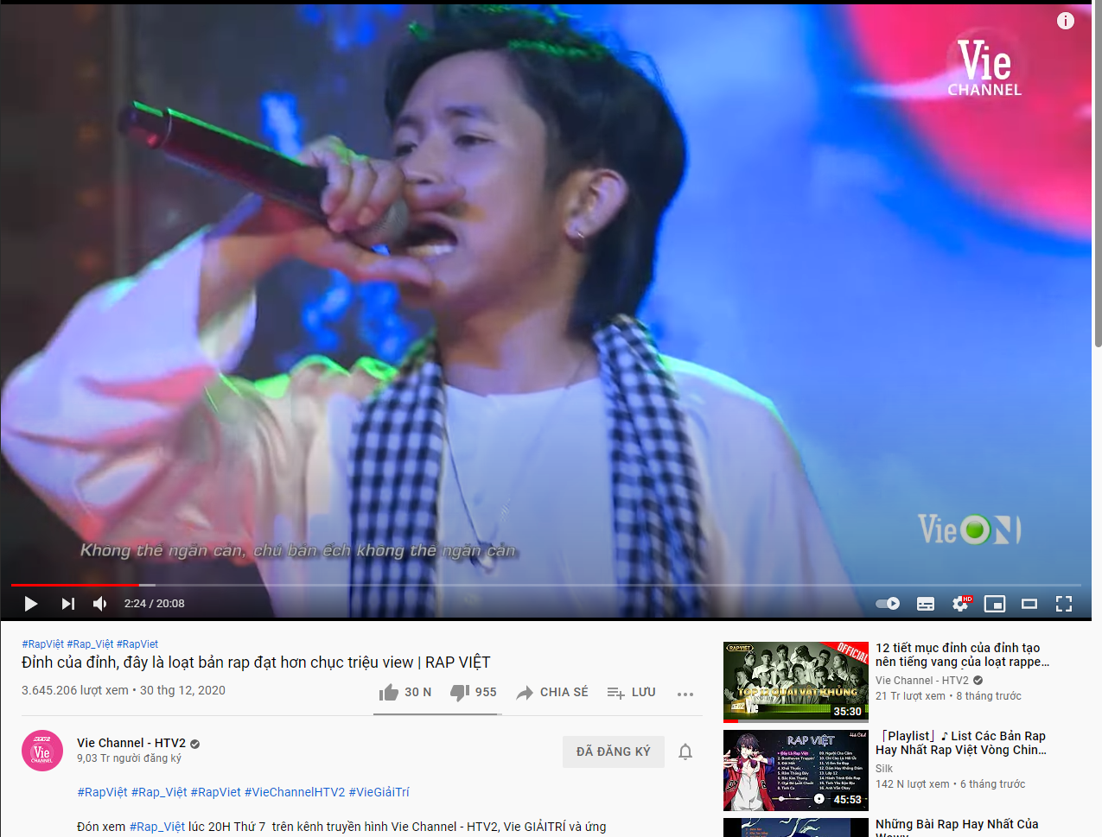
Choosing three Vietnamese videos on YouTube with at least 100 comments. Crawling the first 100 comments of each videos.

Slide 5
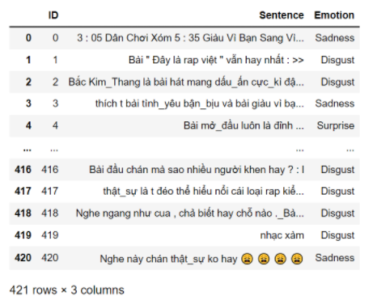
2. Label comments in seven classes: Disgust (chán ghét), Enjoyment(thích thú), Anger (giận dữ), Surprise (ngạc nhiên), Sadness (buồn bã), Fear (sợ hãi),Other (khác).

Slide 6
Emotion Recognition for Vietnamese Social Media Tex
2
Let’s go in depth !

Slide 7
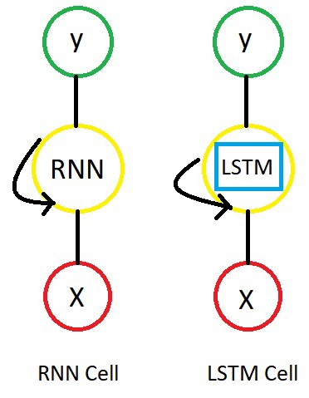
techniques in preprocessing
LTSM:
The Long Short-Term Memory network, or LSTM for short, is a type of recurrent neural network that achieves state-of-the-art results on challenging prediction problems.
Just like RNN, we have time steps in LSTM but we have extra piece of information which is called “MEMORY” in LSTM cell for every time step.

Slide 8
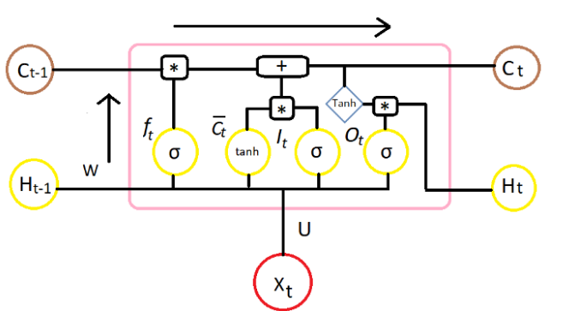
techniques in preprocessing
LSTM cell contains the following components:
Forget Gate “f” ( a neural network with sigmoid)
Candidate layer “C`"(a NN with Tanh)
Input Gate “I” ( a NN with sigmoid )
Output Gate “O”( a NN with sigmoid)
Hidden state “H” ( a vector )
Memory state “C” ( a vector)

Slide 9
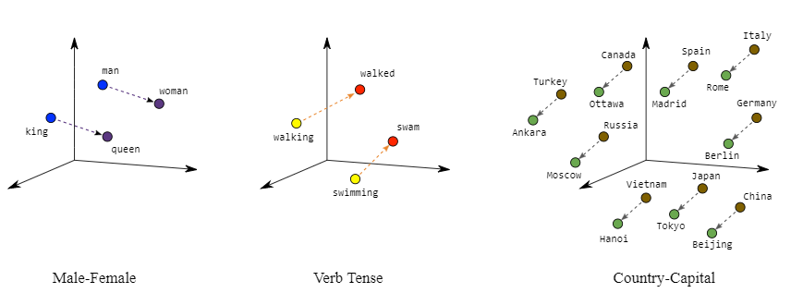
techniques in preprocessing
Word Embedding:
Embeddings translate large sparse vectors into a lower-dimensional space that preserves semantic relationships.
Word embeddings is a technique where individual words of a domain or language are represented as real-valued vectors in a lower dimensional space.

Slide 10
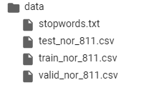
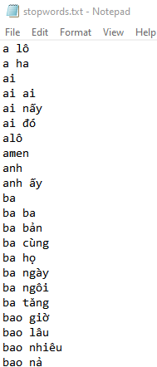
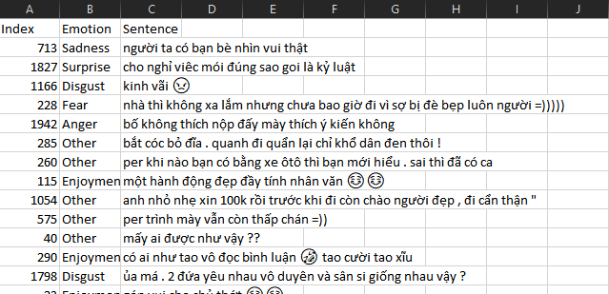
UIT-VSMEC dataset

Slide 11
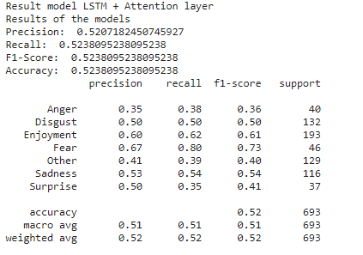
Performance metrics for test set in UIT-VSMEC dataset
Basic Grid-based Algorithm
Define a set of grid-cells
Assign objects to the appropriate grid cell and compute the density of each cell.
Eliminate cells, whose density is below a certain threshold τ.
Form clusters from contiguous (adjacent) groups of dense cells (usually minimizing a given objective function).

Slide 12
task 3: Applying the trained model in Task 2 to three datasets in Task 1. Then, Report performance metrics for datasets

Slide 13
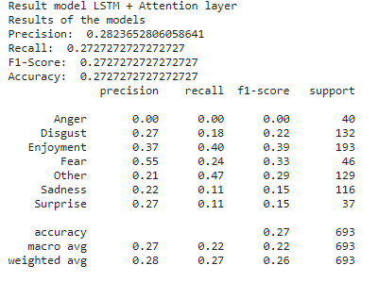
Performance metrics (wait for tung)

Slide 14
Thanks!
Any questions? You can find me at:
@jangg
nttung@mail.me

Slide 15
THANK YOU FOR LISTENING

Slide 16


Team Presentation
Jang IT
Blue is the colour of the clear sky and the deep sea
Tùng IT
Work for a cause, not for applause. Live life to express, not to impress.

